Slide 1
Experiencing a11y
An Intro to Web Accessibility

Slide 2
Schedule Subject to change
1pm – 2pm: Lab
2pm – 3pm: A11y overview
3pm – 3:15pm: Break
3:15pm – 3:45pm: Let’s test
3:45pm – 5pm: Let’s code

Slide 3

Types of adaptive tools

Slide 4
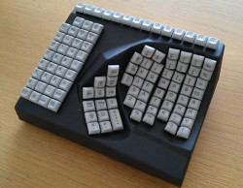
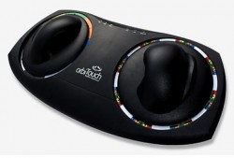
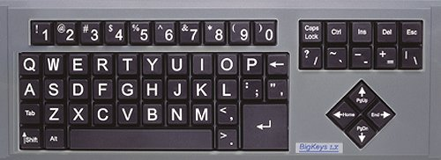
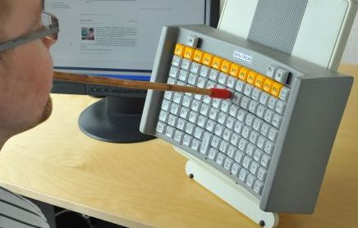
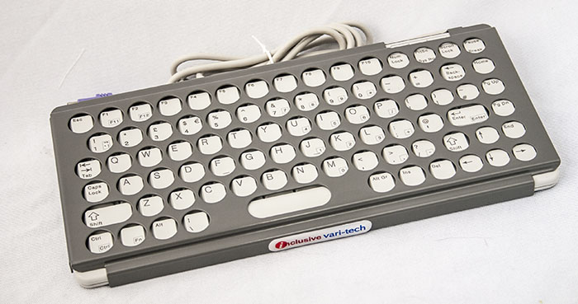

Slide 5
Screen Reader Instructions
NVDA (Windows)
Voice Over (Mac)
To Turn On:
Start App
Keep Default Settings
Screen Reader is now running. Ensure your sound is loud enough to hear.
To Turn Off:
Right Click app from task bar and click “Exit”
To Turn On:
Open system preferences
Select Accessibility
Select Voice Over from the menu
Turn on by clicking Command + F5 or clicking enable box
To Turn Off:
Click Command + F5

Slide 6
Switch
An adaptive switch, alters the interaction scheme between the user and the device making a previously inaccessible method (the buttons are too small and inaccessible for persons with poor motor skills) accessible by using a movement pattern or skill that the person with a disability can more easily perform. *www.c3schools.org/MHEC/WebCT/Adaptive_Switches.doc

Slide 7
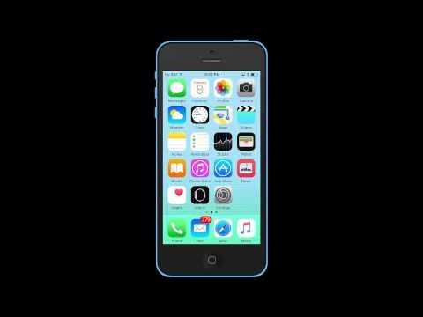
Switch for iOS devices
Settings > General > Accessibility > Switch Control
Notes:
10 Seconds

Slide 8
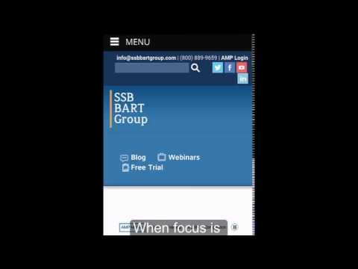
Switch for Android Devices
Settings > Accessibility > Switch Access > Settings
Notes:
25 Seconds

Slide 9
